Slide 1

CSE 473: Pattern Recognition

Slide 2
Recall the Pattern Recognition Approaches So Far
Determine feature vector x
Train a system
Classify the unknown pattern

Slide 3
Recall the Pattern Recognition Approaches So Far
Determine feature vector x
Train a system
Classify the unknown pattern
However, many patterns
  are structural
  have relational information
  are difficult to extract traditional feature vectors

Slide 4
Alternate approach:
Syntactic /Structural Pattern Recognition

Slide 5
Syntactic Pattern Recognition (SyntPR)
Class 1
Structure
Class 2
Structure
Class c
Structure
Library of classes
Structural Analysis
Structural Match
Relevant Matches
Input

Slide 6
Syntactic Pattern Recognition (SyntPR)
Class 1
Structure
Class 2
Structure
Class c
Structure
Library of classes
Structural Analysis
Structural Match
Relevant Matches
Input
SyntPR is used for
  classification
  description

Slide 7
Syntactic Pattern Recognition (SyntPR)
Class 1
Structure
Class 2
Structure
Class c
Structure
Library of classes
Structural Analysis
Structural Match
Relevant Matches
Input
SyntPR assumes
  Pattern is quantifiable
Quantification is through
  Formal grammar
  Relational description or graph

Slide 8
Syntactic Pattern Recognition (SyntPR)
Formal grammar uses
  parsing
  hierarchical decomposition
Graph based approaches uses matching

Slide 9
SyntPR using Grammars
Formal grammar can provide
  efficient use of production rules
  hierarchical decomposition
  analysis, description and classification of complex patterns

Slide 10
SyntPR using Grammars
Example: the baby walks smoothly

Slide 11
SyntPR using Grammars
Example: the baby walks smoothly
Use production rules to analyze the sentence:
  <sentence>

Slide 12
SyntPR using Grammars
Example: the baby walks smoothly
Use production rules to analyze the sentence:
  <sentence>
  <noun phrase> <verbal phrase>

Slide 13
SyntPR using Grammars
Example: the baby walks smoothly
Use production rules to analyze the sentence:
  <sentence>
  <noun phrase> <verbal phrase>
  <article> <noun> <verbal phrase>

Slide 14
SyntPR using Grammars
Example: the baby walks smoothly
Use production rules to analyze the sentence:
  <sentence>
  <noun phrase> <verbal phrase>
  <article> <noun> <verbal phrase>
  the baby <verbal phrase>

Slide 15
Preliminaries of Grammars
An alphabet, V: nonempty, finite set of primitive symbols
  Example: V = {a, b ,c, . . ., z}

Slide 16
Preliminaries of Grammars
An alphabet, V: nonempty, finite set of primitive symbols
  Example: V = {a, b ,c, . . ., z}
String of different sizes:
  V
  V² = V º V, Example: ac, bx, jk, . . .
  V⁺ = V U V² U V³ U . . .
  V* = {є} U V U V² U V³ U . . .

Slide 17
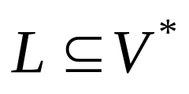
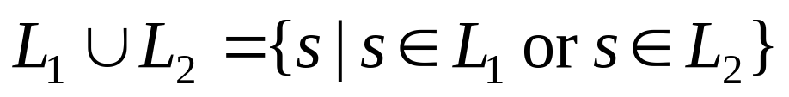
Preliminaries of Grammars
Language, L: set of strings
  Union:

Slide 18
Preliminaries of Grammars
Language, L: set of strings
  Union:
  Concatenation:

Slide 19
Elements of a Grammar (G)
Set of Terminals, V_{T}
Set of Non-terminals, V_{N}
Set of Productions, P
Starting Symbol, S
G = (V_{T}, V_{N}, P, S)

Slide 20
Elements of a Grammar (G)
Set of Terminals, V_{T}
Set of Non-terminals, V_{N}
Set of Productions, P
Starting Symbol, S
G = (V_{T}, V_{N}, P, S)
The language generated by G is L(G)

Slide 21
Application Modes of a Grammar
Generative
Analytic

Slide 22
Application Modes of a Grammar
Generative
  Given a grammar, generate a sentence (string of terminal symbols)
Analytic

Slide 23


Application Modes of a Grammar
Generative
  Given a grammar, generate a sentence (string of terminal symbols)
Analytic
  Given a grammar, determine:
    is sentence, s, generated from G? that is,
    If so, get the structure of the sentence

Slide 24
Application of Grammar in PR
Analytic
  Given a grammar, determine:
    is sentence, s, generated from G? that is,
    If so, get the structure of the sentence
A class can be characterized using a Grammar, G
The unknown pattern can be represented as a sentence, s
Determine:

Slide 25
Notations of Grammars
Capital letters, A, B, C:
  Non-terminals, V_{N}

Slide 26
Notations of Grammars
Capital letters, A, B, C:
  Non-terminals, V_{N}
Small letters, a, b, c:
  Terminals, V_{T}

Slide 27
Notations of Grammars
Capital letters, A, B, C:
  Non-terminals, V_{N}
Small letters, a, b, c:
  Terminals, V_{T}
Greek letters, α, β:
  strings consists of terminals and/or non-terminals, (V_{T} U V_{N})*

Slide 28
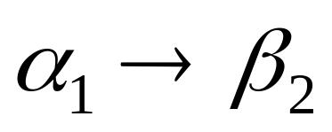
Types of Grammars

Slide 29
Types of Grammars
Type 0: Free or Unrestricted
  No restriction on any side

Slide 30
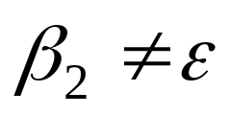
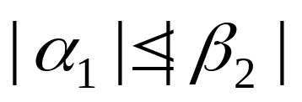
Types of Grammars
Type 0: Free or Unrestricted
  No restriction on any side
Type 1: Context sensitive

Slide 31
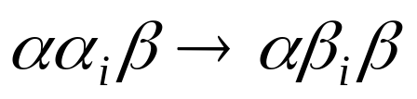
Types of Grammars
Type 0: Free or Unrestricted
  No restriction on any side
Type 1: Context sensitive

Slide 32
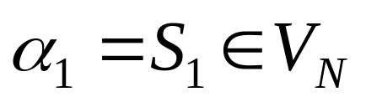

Types of Grammars
Type 1: Context sensitive
Type 2: Context Free

Slide 33


Types of Grammars
Type 2: Context Free
Type 3: Regular or Finite State grammar (FSG)

Slide 34
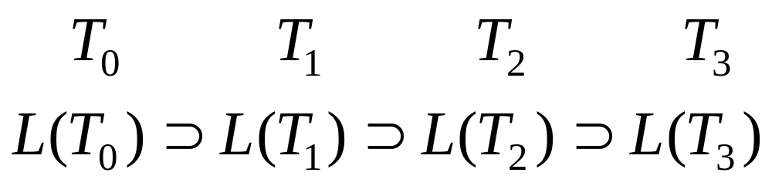
Comparison of Grammars
Grammar Types
Languages
Increasing Production Constraints
Increasing Description Capability
Increasing Recognition Capability

Slide 35
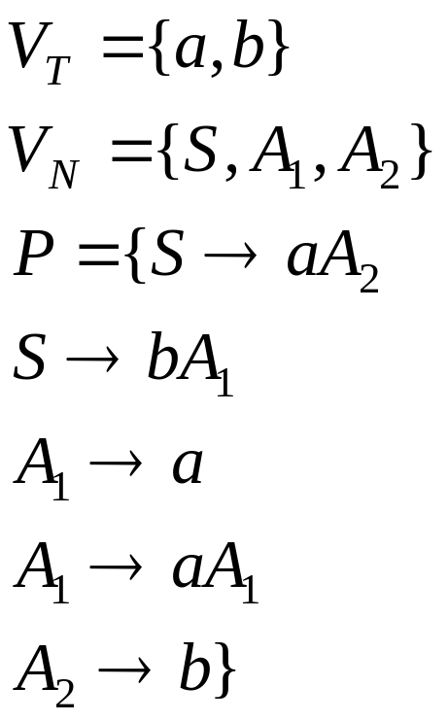
Graphical Representation of FSG

Slide 36
Graphical Representation of FSG
Get nodes for each non-terminal symbols including S and T
S
A₁
A₂
T

Slide 37
Graphical Representation of FSG
For each A_{i}->aA_{j}, make edge from A_{i} to A_{j} labeled with a
S
A₁
A₂
T

Slide 38
Graphical Representation of FSG
For each A_{i}->aA_{j}, make edge from A_{i} to A_{j} labeled with a
S
b
a
A₁
A₂
a
T

Slide 39
Graphical Representation of FSG
For each A_{i}->a, make edge from A_{i} to T labeled with a
S
A₁
A₂
a
b
T

Slide 40
Graphical Representation of FSG
S
b
a
A₁
A₂
a
a
b
T

Slide 41
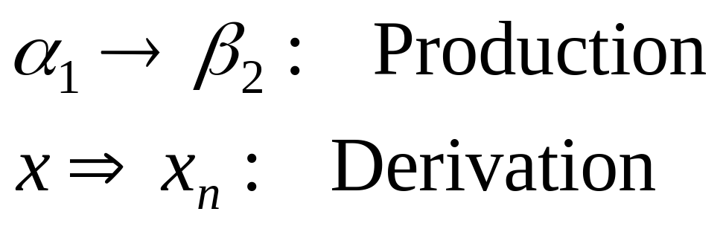
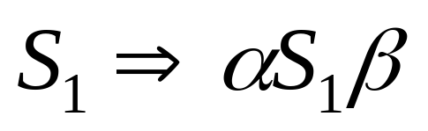
Other Definitions Related To Grammar
Production vs. Derivation
Recursive grammar, if G allows

Slide 42
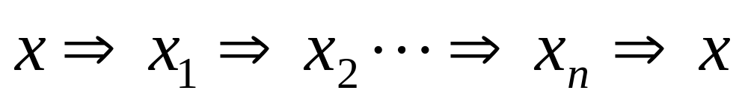
Other Definitions Related To Grammar
Recursive grammar, if G allows
Cycle Free, if there is no derivation like this

Slide 43
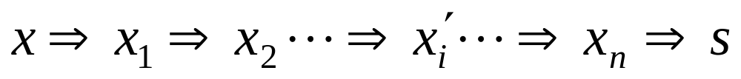
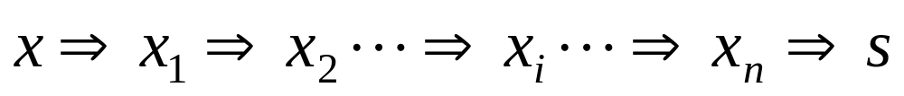
Other Definitions Related To Grammar
Ambiguous Grammar, if G allows

Slide 44
Other Definitions Related To Grammar
Ambiguous Grammar, if G allows
More that one derivation for the same s
More that one parse tree for the same s

Slide 45
Other Definitions Related To Grammar
Equivalence of Grammars
  G₁ and G₂ are equivalent iff L(G₁) = L(G₂)

Slide 46
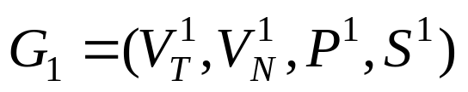
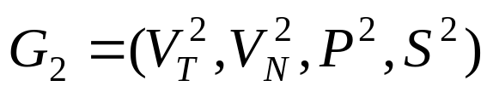
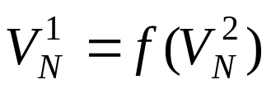
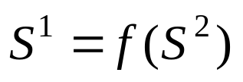
Other Definitions Related To Grammar
Equivalence of Grammars
  G₁ and G₂ are equivalent iff L(G₁) = L(G₂)
covering
    covers if there exists mapping f such that
      P¹ is obtained from P² replacing corresponding symbols

Slide 47
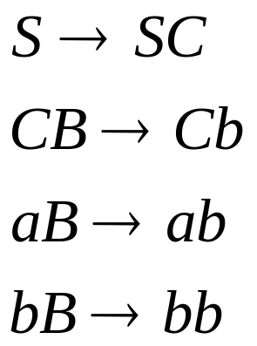
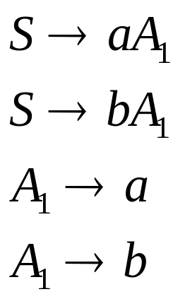
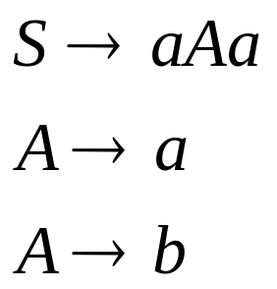
Example of Some Grammars
?
?
?

Slide 48
Example of Some Grammars
CFG
CSG
FSG

Slide 49
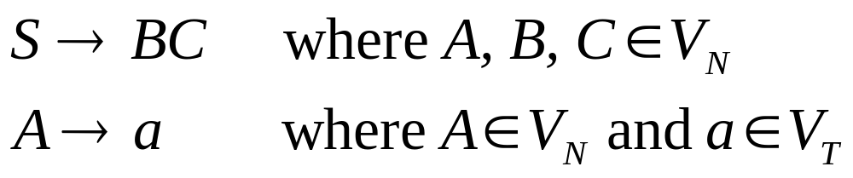
Chomsky Normal Form

Slide 50










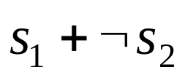
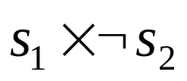
Example: A Line Drawing Grammar
Terminal Symbols

Slide 51
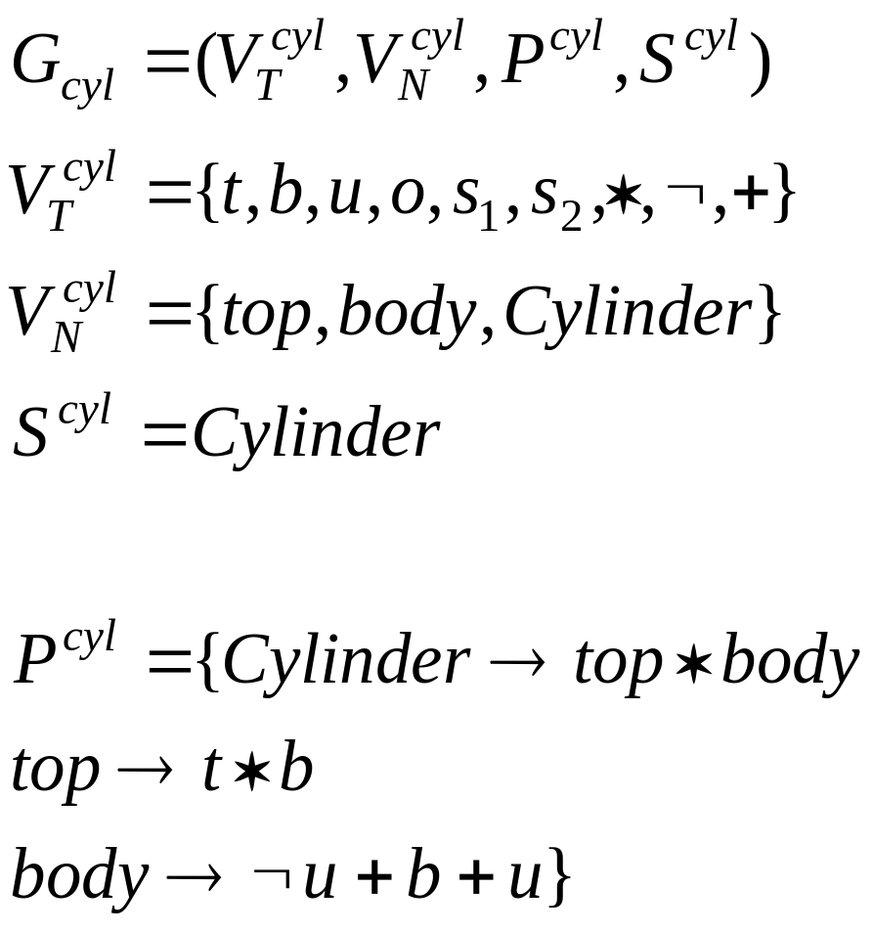
Example: A Line Drawing Grammar

Slide 52


Example: Cylinder

Slide 53

Example 2: Characters

Slide 54
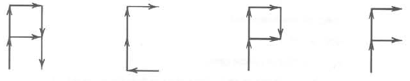
Example 2: Characters

Slide 55


Example 2: Characters
*

Slide 56


Example 2: Characters
*

Slide 57
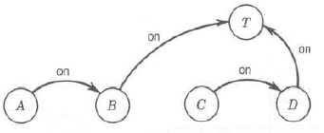

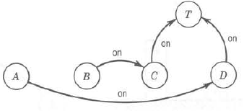

Example 3: Block World Representation

Slide 58
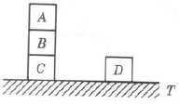
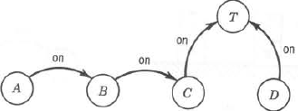
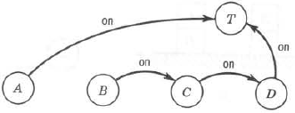
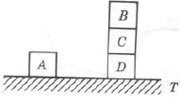
Example 3: Block World Representation

Slide 59

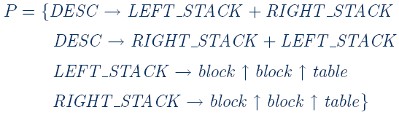
Example 3: Block World Representation

Slide 60
Example 3: Block World Representation

Slide 61
Example 3: Block World Representation

Slide 62
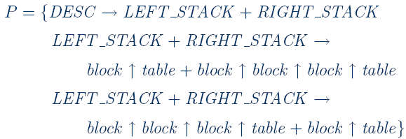
Example 3: Block World Representation

